Slide 1
Proposal: Allow Living in Campers and Trailers in Greenfield
From: Chuck Green September 10, 2024
Housing shortage and challenges:
Susan Worgaftik: Shortage of 600-1000 housing units (about ⅕ of current total)
  Count finds ~250 unhoused in the coldest weather, hundreds more “under housed”.
  Affecting many residents, not just impoverished and unhoused, but also differently-abled, seniors, young families. Everyone is paying. Why?
  Rent burden extremely high. Landlords have no economic incentive to lower.
  Costs to purchase a home, and/or construction, are out of reach for most.
    Affordable housing funding unlikely to fix even in the long term.
    Building trades shortage leads to high costs. Builders have no economic incentive to lower.
  People trying to do their own construction face extreme challenges (e.g. building codes).
Being unhoused costs us all. It is the basis for being “part of the system”:
  Without an address, difficult to get ID documents, health care, a job…
  No security for self, possessions such as a car. Dangerous potential for victimization.
  Vulnerable to trafficking, being robbed, discrimination, stigma.
  We all pay for services for people, including emergency medicine, policing, food…
HOW TO FIX??

Slide 2
Proposal: Allow Living in Campers and Trailers in Greenfield
WHERE: On private property, with owner’s permission
HOW: Used campers can be found relatively cheaply (e.g. a few hundred dollars)
HOW: Used campers are already built and readily available
HOW: Property owner can provide utilities or use of their facilities (e.g. washroom)
If not already included, RV heat pumps and insulation are available at a moderate cost
WHY: Campers were built at a factory according to requirements and regulations.
Better than tents or unpermitted construction!
WHY: Requires no direct funding from the city. WHEN:
WHY: Requires no organization from the city. Can happen immediately.
WHY: Potential to eliminate or reduce shortages. Could lower market rents!
WHY: Having a secure place to live enables people to build their lives – obtain work, documents etc.
Increasing our workforce benefits the city economically, including through increased spending
HOW: Greenfield Zoning Ordinance prohibits (pg 99, 03/2024). No other laws prohibit.
HOW: Delete Zoning Ordinance section ~200-7.11, parts A and B.
Modify section C, which requires meeting city health and safety codes, to apply to utilities only

Slide 3
Proposal: Allow Living in Campers and Trailers in Greenfield:
WHY NOT?
WHY NOT: Health and Safety – Campers may not have been designed for long term living. Campers may be old and have reduced function.
  BUT: Better than people living in tents and makeshift shelters.
  Where utilities are provided, would required permitting be too much load on the city?
  >> If there is this level of demand from parcel owners, that is a good thing for housing!
WHY NOT: Property owners may find it difficult to evict campers they have allowed
  BUT: This is similar to the situation with rental housing units
WHY NOT: Character of the neighborhood. Ugly. Smelly. Too crowded. Trash.
  BUT: Worse than existing encampments?
  How to address:
    People can dispose of trash legally.
    Require setbacks. Limit numbers (see suggestions on next slide).
    Support utility connections by allowing permitted installation.
Some concerns could be motivated by fears and stigma.
Greenfield is a small city. All of our residents are of value. It could be you too.

Slide 4
A Starting Point for a Positive Discussion
Amendment proposals received:
Property owners need to file a permit to register all mobile units on their property
  Support enforcement of health and safety codes for utilities if provided
  Paved or gravel parking. Permitted electrical and other utility connections (pedestals).
  Limits on existing septic systems. Insulation for water and wastewater connections.
Limits to number of residents (determined by size of unit)
Limit to number of units per size of property
  Example: no more than 1 additional mobile unit on a 0.1 acre property
Prohibition of combustion engines running overnight (for noise, emissions)
Others?

Slide 5
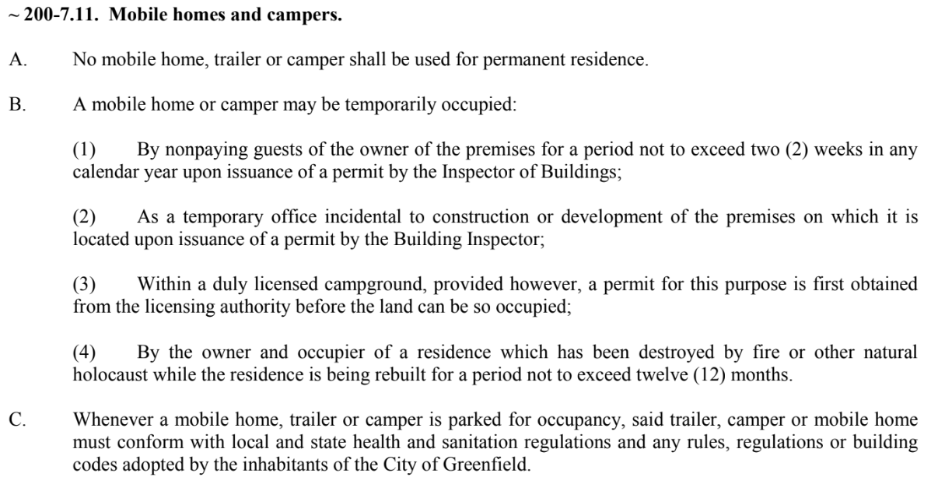
[Page 99, Greenfield Zoning Ordinance, March 2024]
Any utility connections

